Slide 1
GetAnswer.com
“Our job is every student gets their solutions” By Team: The Enthusiasers

Slide 2
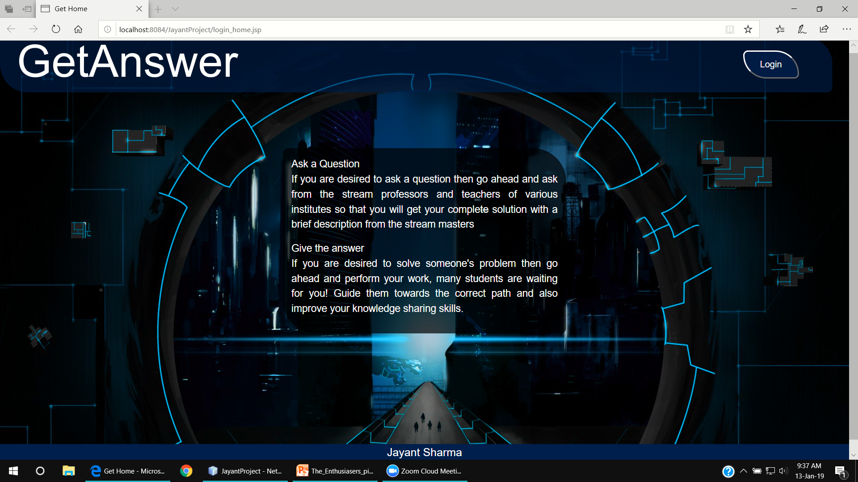

Slide 3
Get Answers from professors without worrying about how and when to get it, just login to us.

Slide 4
Problems
1)The first problem we are going discuss is actually the problem faced by us. During our lectures, we can’t able to get anwsers properly from our teacher due to time contraints or due to busy schedule of teacher in college work.
2)The second problem we face that by reaching to our college teacher only, we are not able to gather the different knowledge, as knowledge is always better if it will be acquired from various wise people.
3)This is obviously the main problem: how we can do above things at anytime, anywhere.

Slide 5
Solution
We observed these problem seriously and found the best solution. The best solution is that we should create a communication link between a teacher and a student, not only with one teacher but with other teachers. And we all know that the best medium is Internet. So we have created a website called GetAnswer.com that acts as an interface between a student and teacher through an Internet.

Slide 6
Innovation you bring in
As it is already discussed that we are creating a new and smart way of communication between a student and a teacher. What student have to do is he or she just have to create an account on our website. Similarly the teacher have to register on our website as a teacher. We actually need is a clean communication between a student and a teacher so that a student easily request the answer of his or her query from the subject teachers and heads. So for that we are mainly divided this domain between two users: A student and a teacher. If a student have occurred some problem and he or she want to ask that query from the stream professor so, what our software will do is it only give the names of that subject teachers. Now from selecting their teachers from the given table, a student can upload a query to those teacher. What additional task it will do is that it will send the mail to all the selected teachers, so that they get notified for a new query. When the teacher uploaded their answer, the student got an email as a notification of answer.
This site didn’t have any social media features so it can be used in organizations as well.

Slide 7
Future Aspects
Currently our project uses java web, but we can implement machine learning to enhance the searching results. i.e. by machine learning, our website links all the interrelated question together. For example two students posted nearly same questions then by machine learning, we can merge similar questions and their answers.
Currently our website is having a one to one relationship between student and teacher, but in future we can make it more social so that the queries are visible to all the users of site.

